Slide 1
Façade Pattern

Slide 2

WANTED
Have you seen this Creature?
Answers to “Grinch”
Caution Hates Christmas and all things festive
Approach with Zero festive cheer

Slide 3
What is a Façade Pattern?
The Façade Pattern is a software design pattern commonly used with object orientated programming.
The Purpose of this pattern is to simplify the code for users and clients by creating a class that calls methods from different areas of the code.
Developers often use the facade design pattern when a system is very complex or difficult to understand because the system has a large number of classes or because its source code is unavailable.

Slide 4
Façade Design Pattern
Example

Slide 5
Animal
String makenoise();
Implements
Dog
String makenoise();
Cat
String makenoise();
Crow
String makenoise();
Calls
NoiseMaker
String DogNoise();
String CatNoise();
String CrowNoise();
Main

Slide 6
So Lets look at the code

Slide 7
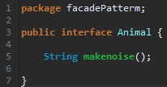
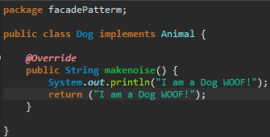
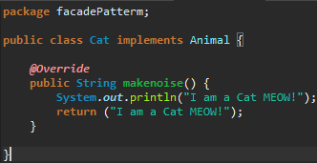
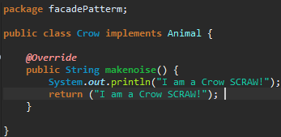
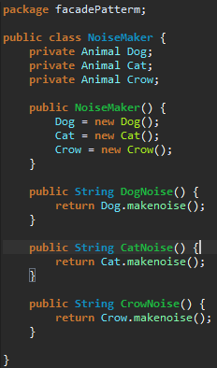
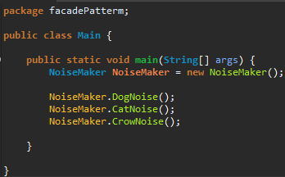

Slide 8
Façade Design Pattern Summary
Simplified interaction with methods located in different places within your code.
Makes complex subsystems easier to use.
Does not actually do any work itself other than direct you to the class with the method that does.

Slide 9

Any Questions?

